Slide 1
NE 763: Advanced Reactor Materials
Fall 2025
Dr. Benjamin Beeler

Slide 2
Last Time
UC restructuring:
3 main zones: 1) interior with large interconnected porosity, 3) high microscopic swelling with grain growth, 4) low porosity, no grain growth
zone 2 only forms at high powers: has columnar grains
UC FCCI:
primary concern is carburization, formation of Cr-C precipitates along grain boundaries and then crystallographic planes; governed by C diffusion into the cladding; FCCI is worse for Na-bonded pins, as C transport to cladding is faster
Carbide fabrication: carbothermic reduction
Started on nitrides: Similar benefits to UC fuels, options for reprocessing, interest from a variety of reactor concepts
UN and U2N3 are main phases, depends on N partial pressure

Slide 3
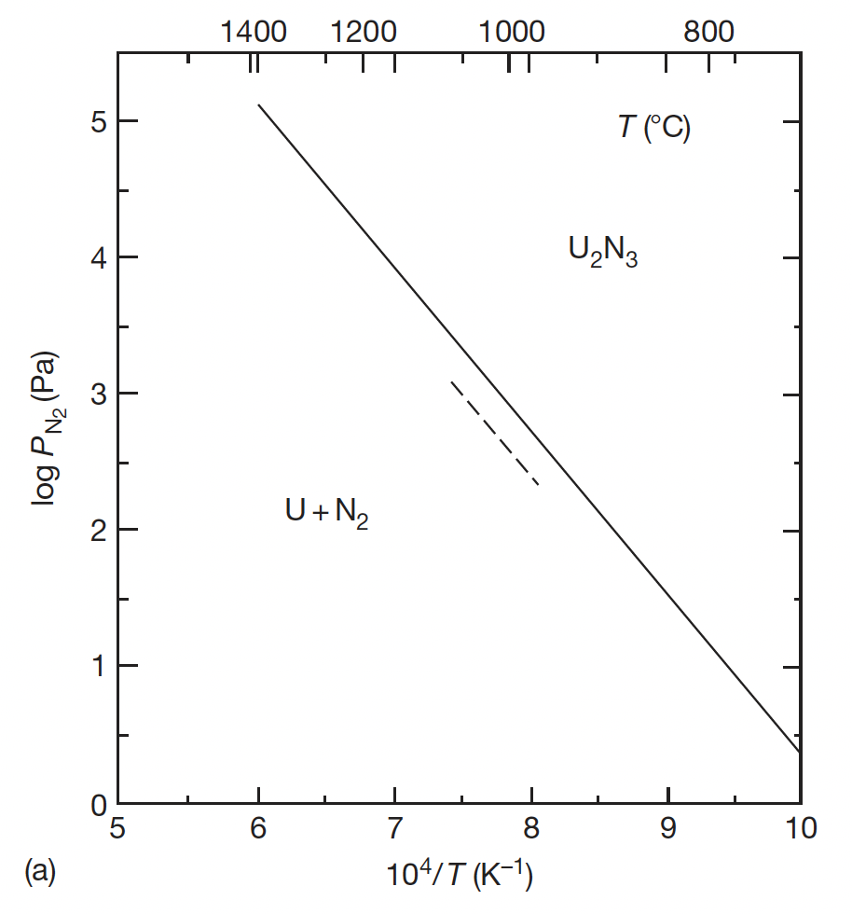
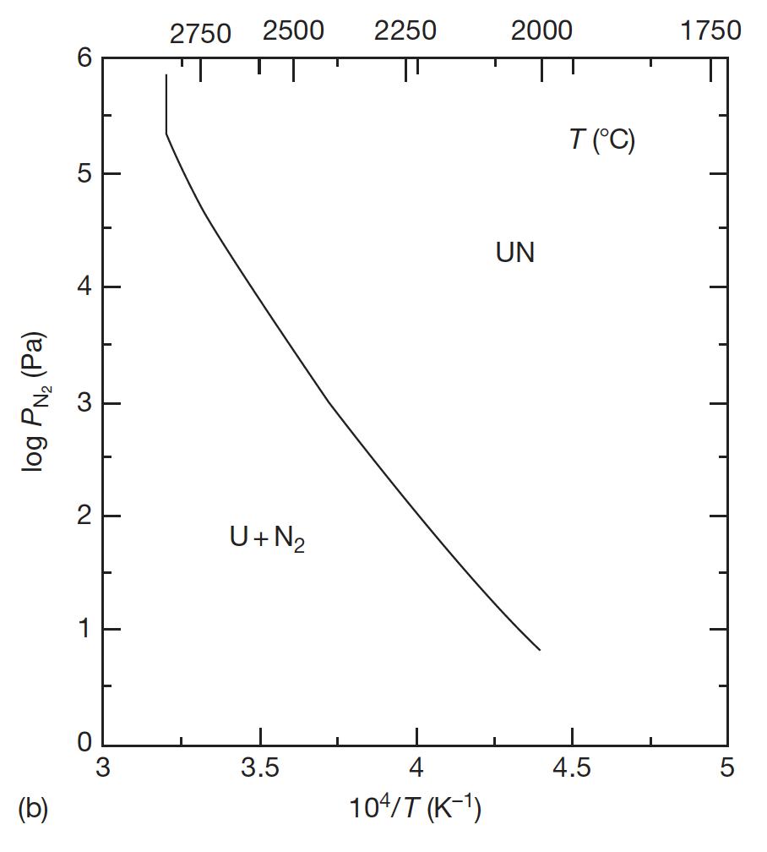
UN Decomposition
The decomposition of U2N3 is the last stage in the formation of UN through carbothermic reduction, thus the equilibrium nitrogen pressure of UN and U2N3 is very important from the viewpoint of their use as nuclear fuels
UN decomposes at 3073K and U2N3 decomposes 1620K at nitrogen pressure of 1 atm

Slide 4
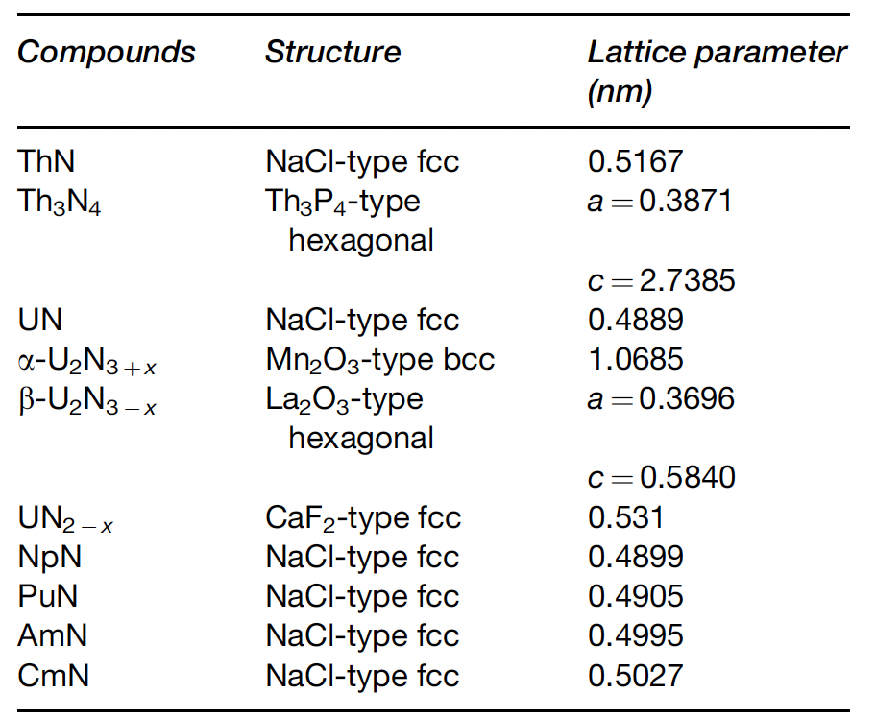
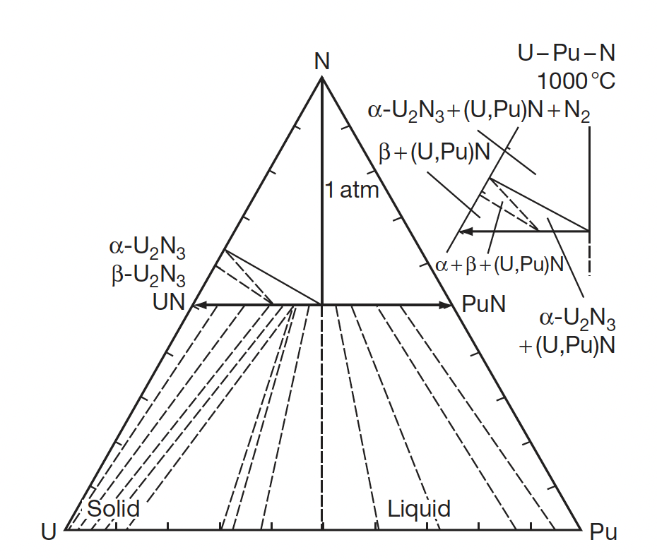
MN Crystal Structure
UN has same NaCl-type close-packed structure as UC
Several actinides also share this NaCl-type structure, and thus can exist as substitutional species in UN/PuN
Allows for fabrication of homogeneous mixed nitride fuels, including MA-bearing fuels

Slide 5
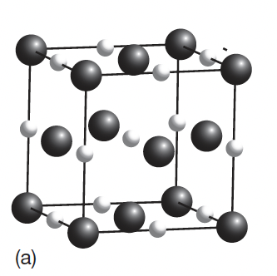
Ternary U/Pu-N
The ternary system is characterized by a complete solubility of UN and PuN
The (U,Pu)N phase has a narrow composition range of the N/(U+Pu) molar ratio
Although Pu2N3 does not exist in the Pu–N system, a sesquinitride phase was identified in the U–Pu–N system at a Pu/(U+Pu) molar ratio of 0.15
In a mononitride lattice with NaCl-type structure, small nitrogen atoms are incorporated into a dense face-centered cubic packing of metal atoms

Slide 6
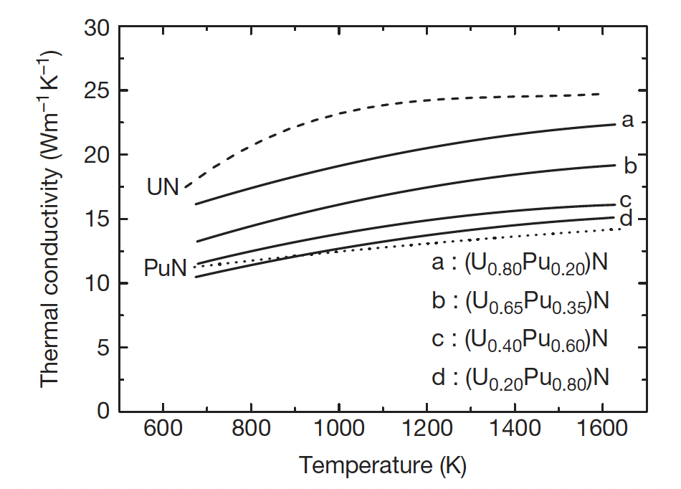
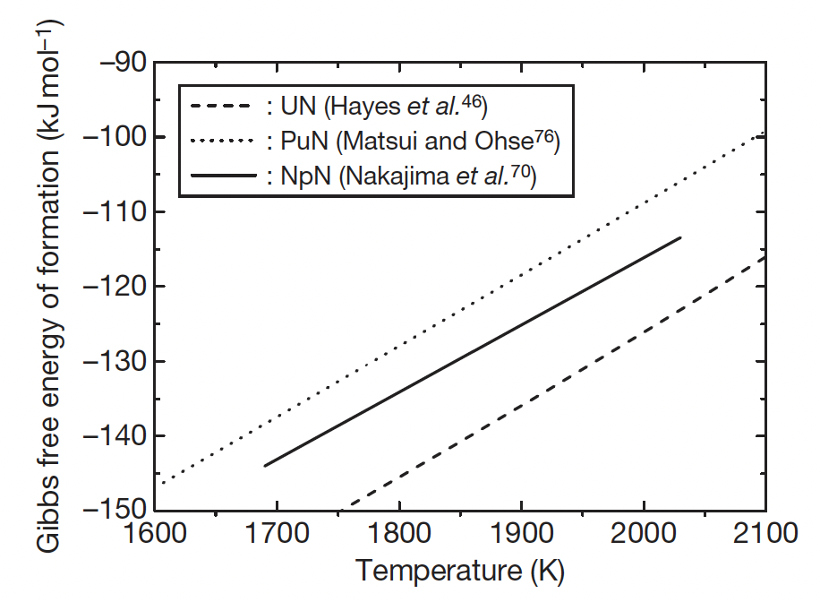
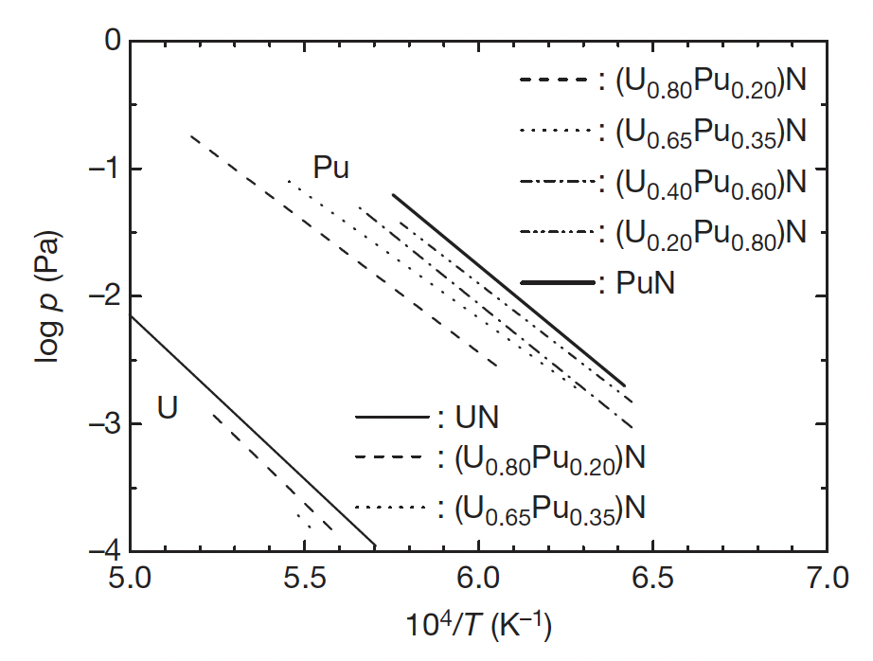
Effect of Pu on U/Pu N Properties
The addition of Pu can dramatically affect thermophysical properties
Pu is more volatile than U, and has a higher vapor pressure
Pu degrades the thermal conductivity by as much as 2X
PuN is less stable than UN, and could be susceptible to radiolysis

Slide 7
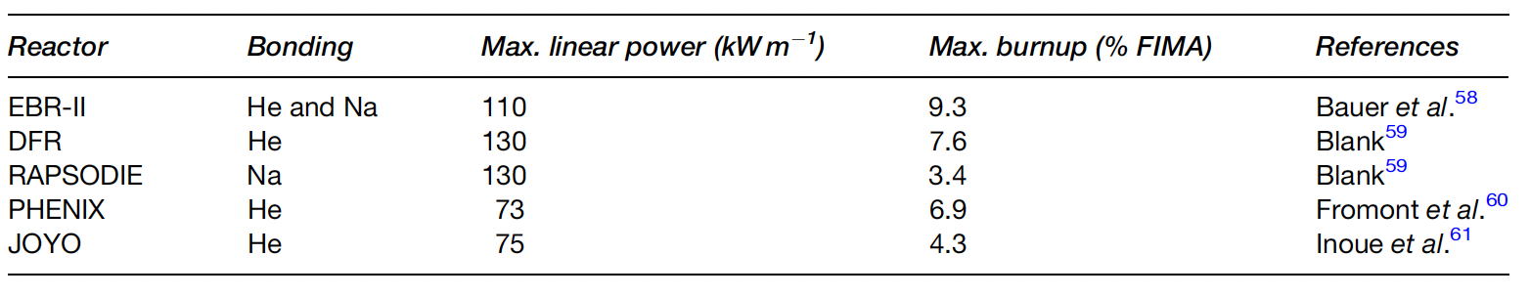
UN Irradiation Performance
The irradiation experience of nitride fuel is rather limited in comparison with the other fuels for fast reactors, such as oxide, metallic, and carbide fuels
The number of (U,Pu)N fuel pins irradiated in fast reactors so far is smaller than 200
UN pins have reached 10% FIMA in fast reactors, and greater than 15% FIMA in thermal reactors

Slide 8
UN Pins
Similar to carbides, pin designs are either He-bonded or Na-bonded
He-bonded fuel pin is characterized by low-density pellets (80–85% of theoretical density (TD)) and a small gap
Na-bonded fuel pin is characterized by high-density pellets (>90% TD) and a large gap
Na-bonded concept has the advantage of keeping the fuel temperature relatively low due to good thermal conductivity of liquid Na
Difficulties with Na are the reactivity in air, and additional hurdles in fabrication and reprocessing

Slide 9
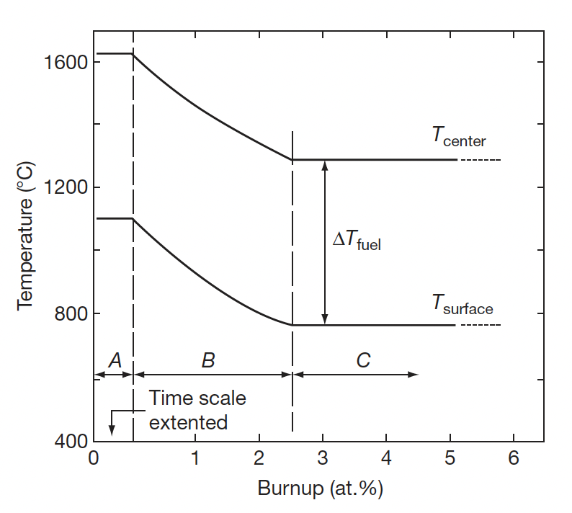
UN Pins
The He-bonding concept is considered as the reference for (U,Pu)N fuel
The temperature of fuel pellets becomes high in comparison with the fuel with Na bonding, especially at an early stage of irradiation
The small gap is closed by free swelling of fuel pellets at a burnup of 2–3% FIMA

Slide 10
Temperature with Burnup
Similar to carbides, have three stages in temperature
Stage A is the first rise of power and lasts for one to several days
Stage B has the resintering of pellets center + swelling and closure of He gap
Stage C is the quasi steady-state irradiation period in which FCMI begins
The theoretical density of the fuel is reduced to ~80% to avoid excessive strain on the cladding

Slide 11
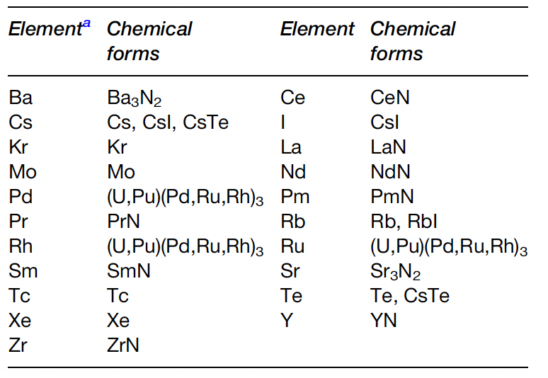
Fission Products
Fission products can form various nitride phases in the fuel matrix
Noble gases will not react with N, and volatile species (Cs, I, Te) will form volatile compounds
Pd, Rh, Ru, Mo, Tc form metallic precipitates
Rare earths and transition metals are dissolved in the U/Pu-N matrix
The N/U ratio was evaluated and reported to increase by 2% at a burnup of 10%
The increase in N can form U2N3 phases

Slide 12
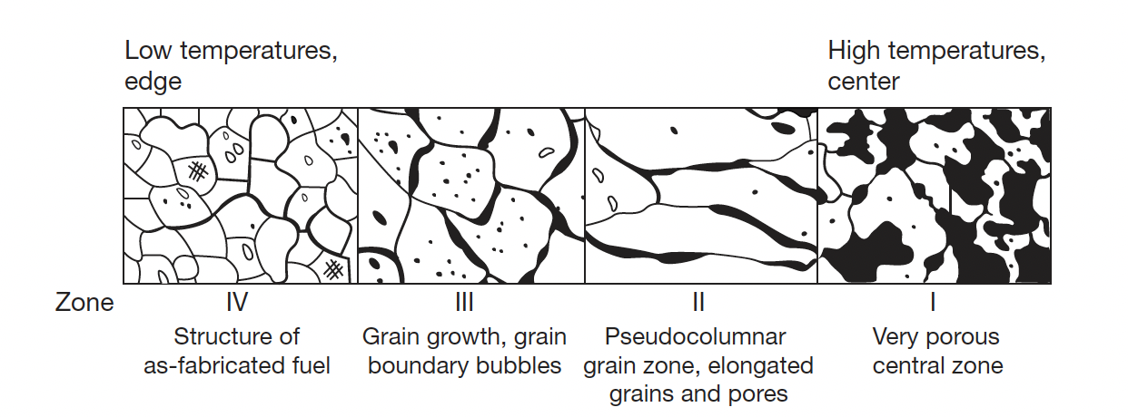
Nitride Restructuring
Because of relatively low fuel temperature and temperature gradient, the restructuring of (U,Pu)N fuel is mild in comparison to MOX fuel for fast reactors
For He bonded pins at high power, restructuring occurs with three distinct zones
Zone 1 is found in the central of the fuel pellet was characterized by very porous structure; a small central hole was sometimes observed (not due to pore migration)

Slide 13
Nitride Restructuring
Zone 2 is found in MOX fuels and sometimes in carbide fuels, but NOT in UN fuels
Zone 3 displays grain growth, grain boundary bubbles, and healing of cracks
Zone 4 has the as-fabricated structure, low swelling, small bubbles
Fission gas release is prevalent in zone 1 and zone 3, with large amount of UN swelling

Slide 14
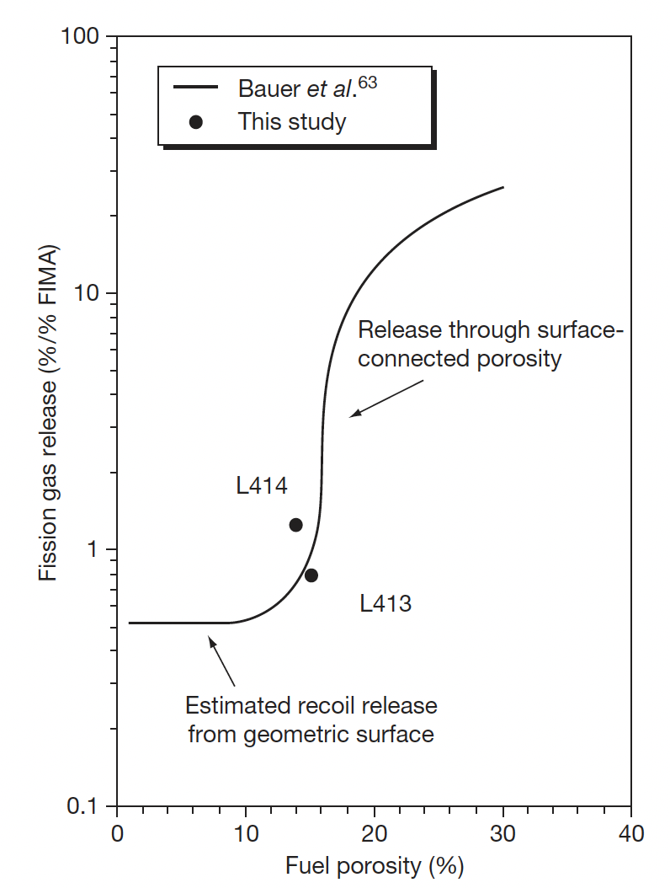
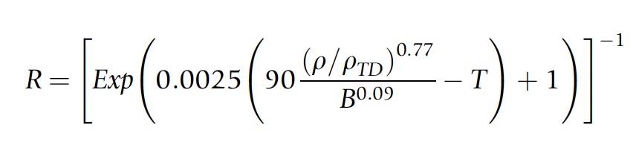
Fission Gas Release
It is generally known that FP gas release of nitride fuel is much lower than that of MOX fuel; Likely due to lower temperatures
There have been no systematic results dealing with fission gas release of nitride fuel, due to limited irradiations
Gas release will be influenced by burnup, pellet density, grain size, the characteristics of porosities, and temperature
Different relations have been developed to account for these factors
Fuel at 4.3% FIMA

Slide 15
Swelling and FCMI
Since FG release is low, its possible that swelling is large
Volumetric swelling is caused by the accumulation of solid FP and crack formation in the pellets
The volumetric swelling rate of (U,Pu)N fuel irradiated to 9.3% FIMA was evaluated at 1.83% per FIMA% without the constraint of the cladding tube
This is considerably higher than UO2 fuels, but lower than metallic fuels
The creep rate of (U,Pu)N fuel is low in comparison with MOX or metallic fuel at operating temperatures due to a slow diffusion rate of metal atoms in nitride fuel
Thus, focus has been placed upon the degree of FCMI in UN fuels
FCMI in a general sense can be mitigated by the reduced TD and operating at a reasonable linear power (<100kW/m)

Slide 16

Swelling and FCMI
High power He-bonded pins with high TD caused a number of cladding failures, leading to suggested conditions of <80 kW/m and TD ~ 75%
Thus, FG swelling is is highly temperature dependent (power and kth)
Solid swelling is estimated at 0.5% per % FIMA
This is significantly lower than metallic fuels
Swelling correlations have been developed taking temperature, burnup, and as-fabricated density into account

Slide 17
FCCI in UN
Similar to carbide fuels, but without the problems of carburization
Pure UN and PuN are stable with respect to most major cladding constituents
Hypostoichiometric MN that contains free U or Pu should be avoided as a eutectic melting reaction with the cladding can occur
Formation of (U,Pu)Fe2 and (U,Pu)Ni5-type intermetallic compounds – same as carbides
In systems with excess N, U2N3 can be stripped of N to form Fe, Ni, and Mo nitrides
Thus, hyperstoichiometric UN is less compatible with cladding

Slide 18

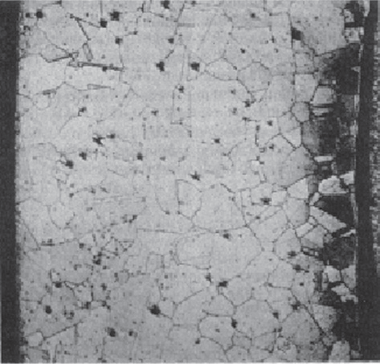
Cladding Nitriding
Hyperstoichiometric MN containing sesquinitride (U2N3) can cause nitrogen penetration and form a reaction layer at the cladding inner surface
Since N/U increases with burnup, more N becomes available with time
Oxygen impurities present can convert the fuel into oxide form, freeing nitrogen and allowing for nitriding
Excessive nitriding of cladding materials has not been reported
Appearance of clad nitriding of Type 304 stainless steel cladding

Slide 19
Reprocessing
Both hydrochemical and pyrochemical processes were proposed for the reprocessing techniques
The disposal of long-lived ¹⁴C and the recovery of expensive ¹⁵N are key topics in reprocessing
Hydrochemical processes produce a nitric acid solution of U+Pu to be converted to oxide, and then to nitride by carbothermic reduction
Pyrochemical processing similar to that for metallic fuel can also be applied for nitrides
Conversion to an oxide may be performed for the purpose of N-15 recovering via exposure to air

Slide 20
Nitride Fabrication
Similar to carbide fuels, preparation of nitrides from either metallic sources or from the hydriding-dehydriding process were explored in the 1960s and remain an option for laboratory implementation
These reactions are exothermic and should be carried out slowly by temperature cycling for better control of the products
It is difficult to apply the metal or hydride route for large scale production
These processes include the nitridation of U or Pu metal in N2 or NH3 at 1073–1173 K, arc-melting of U or Pu metal under N2 pressure, nitridation of fine-grained U or Pu powder formed by the decomposition of hydrides with N2 or NH3 and direct reaction of UH3 or PuH_{2.7} with N2 or NH3

Slide 21

Carbothermic Reduction
Carbothermic reduction is the most widely used process for preparing nitride fuel
The starting material is a dioxide and carbon, and the general reaction is
The mixture of dioxide and carbon is heated in N2 gas stream, usually at 1773–1973 K
An excess amount of carbon is usually added to the mixture to reduce the oxygen content
The initial C/MO2 mixing ratio was historically chosen at 2.2–2.5 for the preparation of UN and (U,Pu)N
The residual carbon is removed from the products by heating in a N2-H2 stream
After removal of excess carbon, the atmosphere is changed to Ar or He from N2 or N2–H2 to prevent the formation of higher nitrides

Slide 22
Carbothermic Reduction
Typical impurities in nitride fuel prepared by carbothermic reduction are oxygen and carbon
The level of impurities can be kept lower than 1000 ppm for both oxygen and carbon by adjusting the initial C/MO2 mixing ratio
Carbonitrides (U/Pu-C-N) have complete solubility in the MN systems, while oxides have solubility around 10%
MA-N can be manufactured in the same way, but has different C, N, and O potentials, requiring slightly different mixtures of streams
Am also has a high vapor pressure and it is a challenge to keep it from vaporizing during fabrication, this requires operating at lower temperatures for the N2 stream
Unlike carbides, Pu volatilization is not an issue

Slide 23
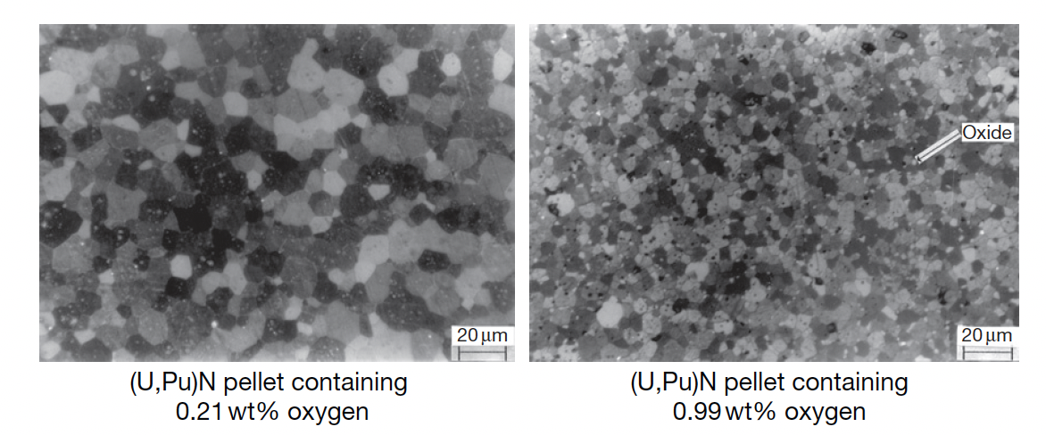
Nitride Pellets
Nitride fuel pellets are usually prepared by a classical powder metallurgical manner; the product of carbothermic reduction is ground to powder by use of a ball mill, pressed into green pellets and sintered in a furnace at 1923–2023 K
Actinide nitride powder has a low sinterability in comparison with that of oxide or carbide powder, which is derived from a low diffusion rate of metal atoms in mononitrides
A high sintering temperature (i.e., T>1973 K) is necessary for preparing dense UN or (U,Pu)N pellets higher than 90% TD
Oxygen impurities tend to promote the sintering of UN, but greater than 1 wt% decreases the density and results in an overly fine grain structure

Slide 24
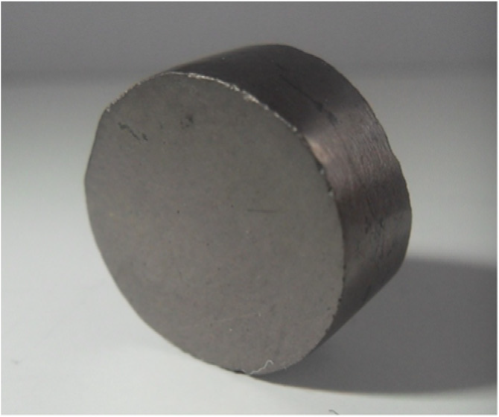
Nitrogen enrichment
Nitrogen enrichment is critical for utilization in thermal reactors, and provides significant benefits for fast reactors
The cost of nitrogen enrichment is currently about 10x that which is needed for economical fuel development
UN pellet produced by spark plasma sintering

Slide 25
Summary
Nitrides have a higher U density and higher thermal conductivity than oxides, with a higher melting point than carbides
Difficult fabrication, requiring atmospheric controls and enrichment of N, especially in thermal or transmutation applications
Carbothermic reduction is the primary fabrication route
Very few irradiations have been performed, none to especially high burnups
Three stages in temperature, with gap closure leading to steady state behavior
Nitride fuel undergoes restructuring, with central porous region, large grained region, and as-fabricated microstructure
FCMI is a key life limiting phenomenon due to little creep in UN fuels

Slide 26
Lead Cooled reactors

Slide 27
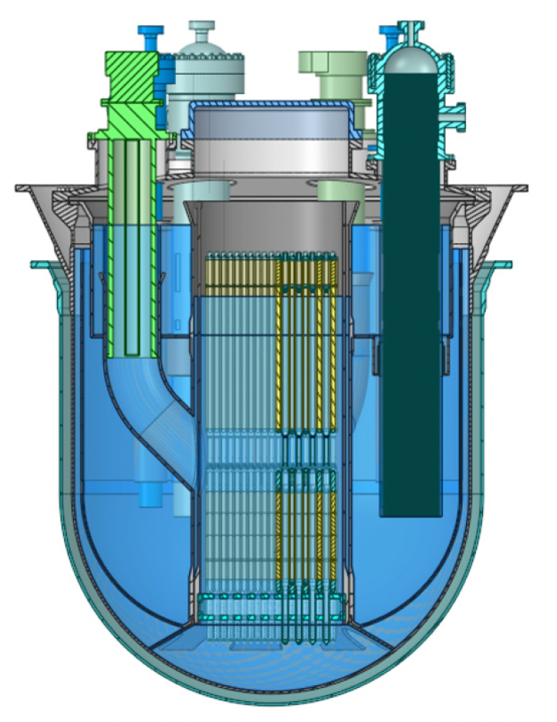
ALFRED Reactor
ALFRED, the advanced lead-cooled fast reactor European demonstrator
ALFRED is a planned demonstrator reactor designed with the specific purpose to test and qualify innovative components and procedures to be used in commercial reactors
Pool type, MOX hollowed fuel pellets, natural and forced circulation
Planned commercial operation in 2035-2040

Slide 28
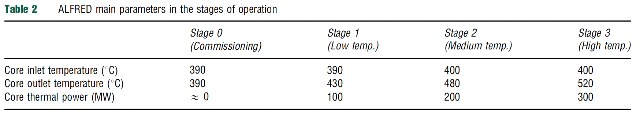
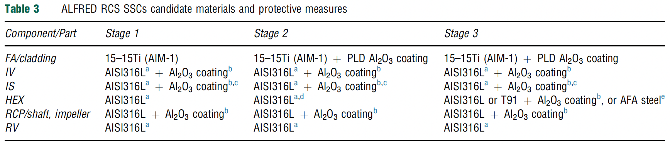
ALFRED Reactor
ALFRED plans to operate in a staged manner for licensing purposes, ramping up activities
Currently planned materials are listed for the different stages, relying heavily on coatings and austenitic steels
An example 15-15Ti steel in the US is D9

Slide 29
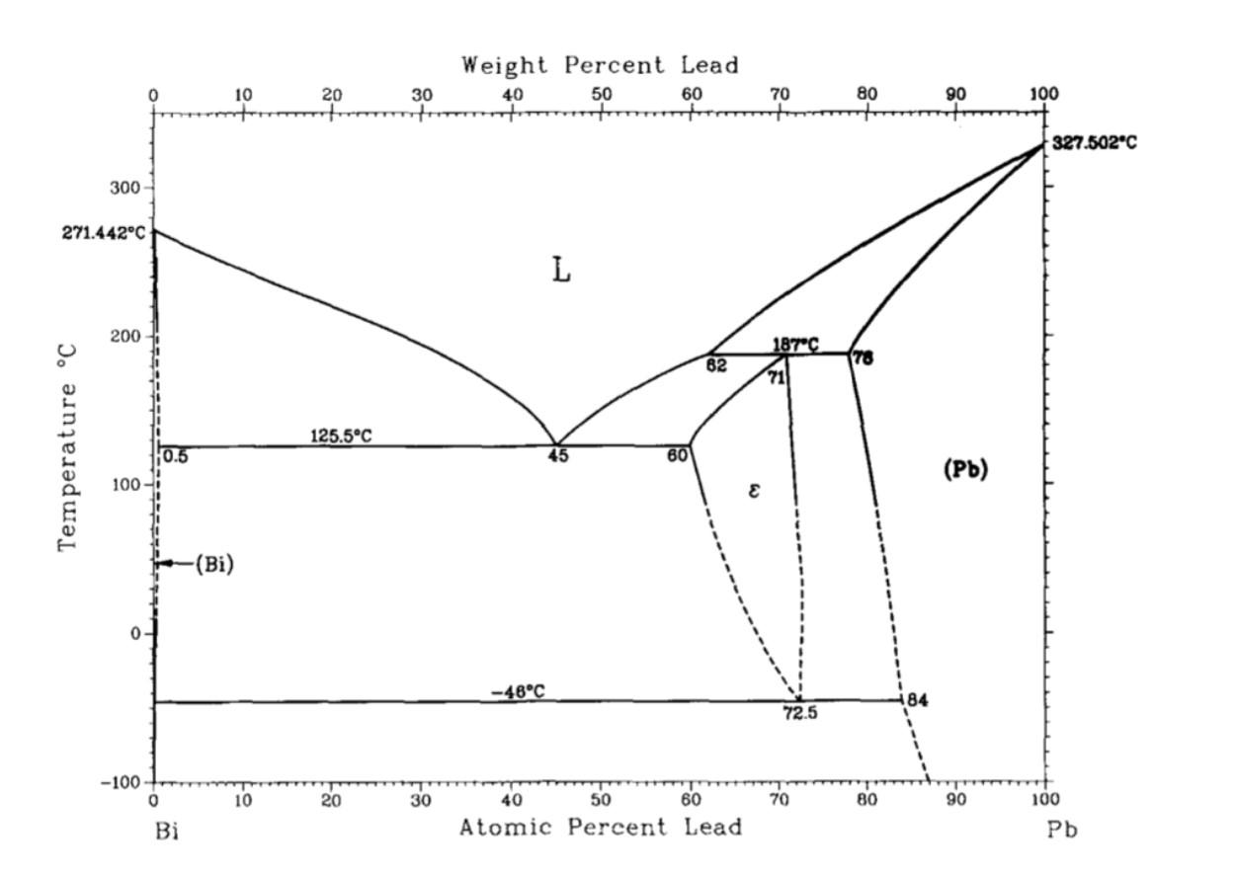
Lead Corrosion
The challenge of using heavy liquid metal coolant (lead and lead-bismuth) is the compatibility with structural materials at high temperature
Pb and lead-bismuth eutectic (LBE) provide highly corrosive conditions for most structural and cladding materials
This is most problematic for thin-walled components such as cladding tubes or heat exchangers
Corrosion in Pb and LBE is due to the dissolution of different constituent elements, their transport, and their chemical reactions with oxygen and nitrogen

Slide 30
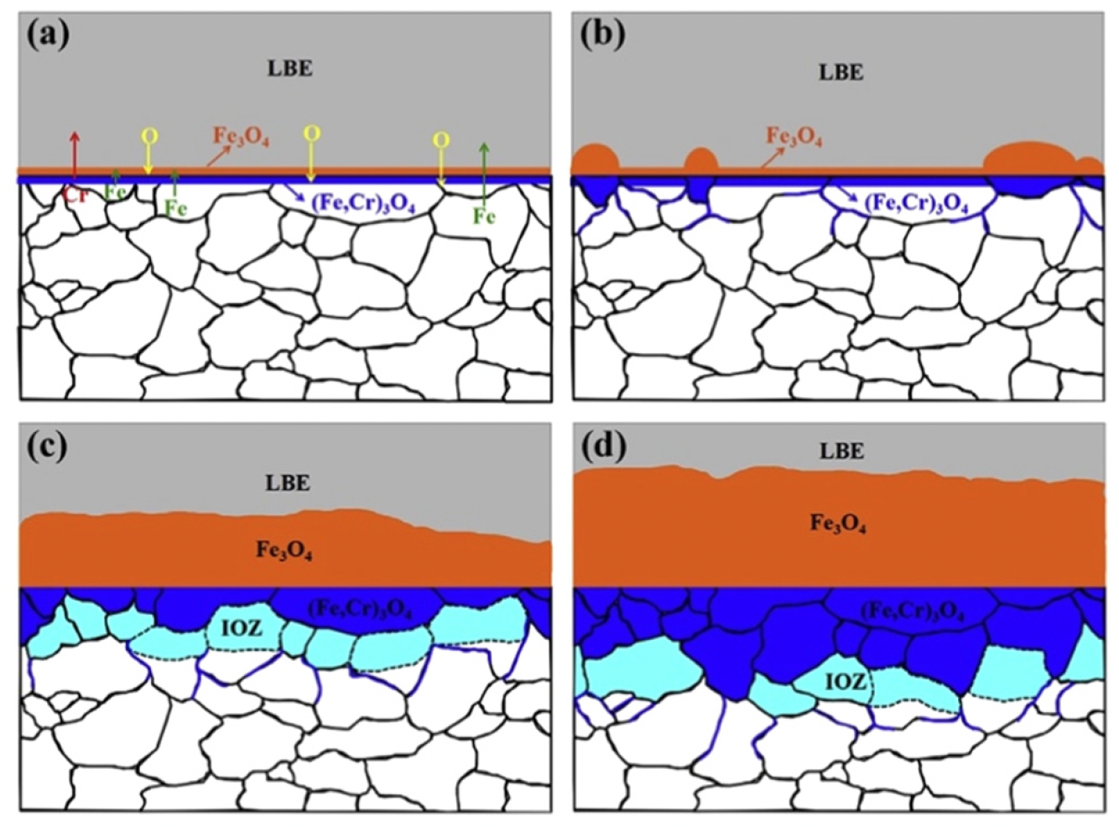
Oxide Passivation
Adequate control of the oxygen concentration allows one to maintain the oxide film, without oxidizing the LBE
If insufficient oxygen is present, the steel will suffer dissolution corrosion
The oxide layer can form as a multi-layered structure dependent upon O content, temperature, and flow, with Fe3O4 and FeCrO2 phases

Slide 31
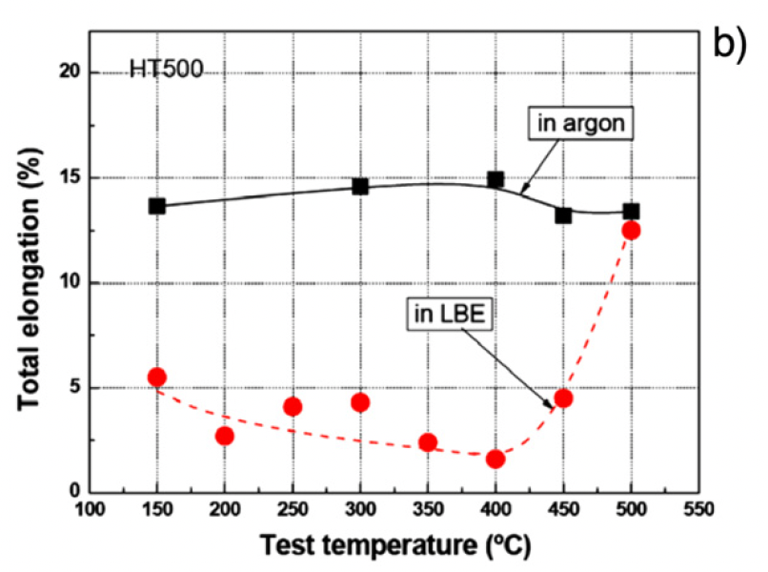
Mechanical Property Effects
Liquid metal embrittlement (LME) is a known phenomenon, but its mechanism is not fully understood
Contact with LM causes a decrease in ductility, resulting in a premature brittle failure in an otherwise ductile material
LME occurs by nucleation of a crack at the wetted surface of a solid and the subsequent propagation into the bulk until ultimate failure

Slide 32
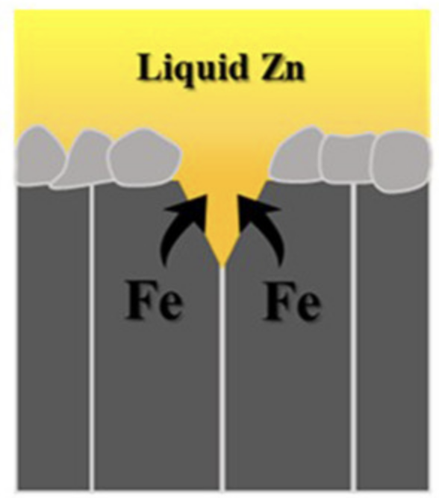
LME
The loss of ductility of solid metals when in contact with liquid metal appears to be limited to a particular temperature range known as the ductility trough
For the F/M T91 steel in liquid lead, a ductility trough between 160C and 425C was found
The ductility trough is detected by following the evolution of the ultimate tensile stress or energy to rupture with temperature
The working theory on LME is based on a reduction of the surface energy by absorption of liquid metal atoms at the crack tip of the solid

Slide 33
End of Module 3
This concludes our module 3
Exam will take place next Tuesday (11/4)
Will cover molten salts, carbides and nitrides (and Pb-cooled reactors?)

